Slide 1
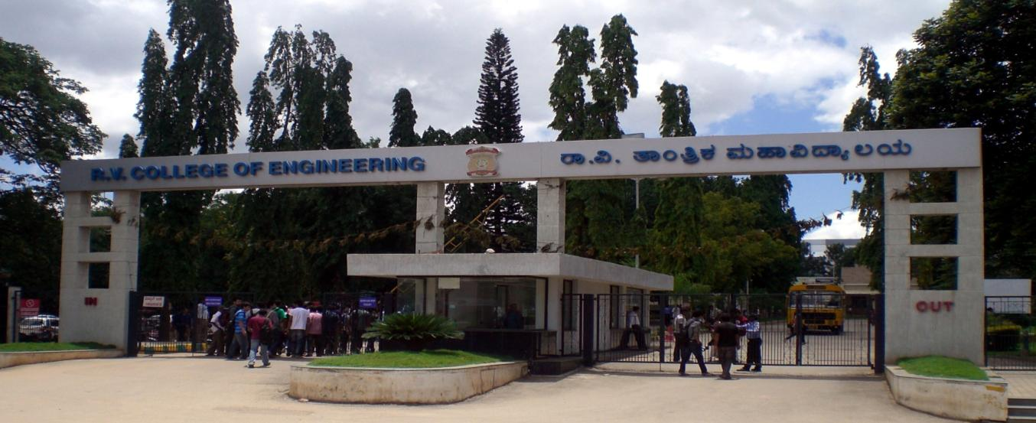
VIII Semester Major Project Work (12CS81)
Department of Computer Science,
R V College of Engineering, Bengaluru.

Slide 2
CCTV Video Summarization in Urban Environments
A.S. Karthik 1RV15CS001
Abhishek Krishna 1RV15CS007
Gagan Deep G 1RV15CS053
Phase-4
Internal Guide : Dr Ramakanth Kumar P (Professor and HoD CSE)

Slide 3
Incorporation of suggestions

Slide 4
Implementation
Specify the flow of the modules .
Flow chart

Slide 5
Hardware and Software requirement
Should contain the following:
Test Environment:
OS: Windows
Tool: Python3 with OpenCV v4
Data: Video footage from cameras
Unit Testing of Main Modules:Unit test concerns in verification effort on the smallest unit of software design, Testing the software components or modules. By testing in this method the bugs occurred will be very clear.
Integration Testing of the Modules :Integration testing is a systematic technique for constructing the program structure while at the same time conducting tests to uncover errors associated with interfacing. The objective is to take unit tested components and build a program structure.

Slide 6
Testing
Unit Testing of Main Modules ( consider all modules with successful and unsuccessful cases )
Sl No. of Test Case
Name of Test Case | Read video
Feature being Tested | Proper loading of video from disk
Description | -
Sample Input | Video file
Expected Output | List of frames in memory if file exists, else error that file is not found
Actual Output | As expected
Remarks | Test case passed successfully

Slide 7
Testing
Unit Testing of Main Modules ( consider all modules with successful and unsuccessful cases )
Sl No. of Test Case
Name of Test Case | Motion detection and masking
Feature being Tested | Detection of motion and generation of mask of movement in the frame
Description | For each frame, motion should be detected and a mask of which part of the frame has motion should be created
Sample Input | List of video frames
Expected Output | List of binary (black and white) masked frames
Actual Output | As expected
Remarks | Test case passed successfully

Slide 8
PUT PICS

Slide 9
Testing
Unit Testing of Main Modules ( consider all modules with successful and unsuccessful cases )
Sl No. of Test Case
Name of Test Case | Background video generation
Feature being Tested | Generation of static background
Description | For a given video, a static background is to be generated from the video with movement so that events can be blended into it, to generate the summary
Sample Input | List of video frames
Expected Output | List of binary frames with minimal/ no movement
Actual Output | Static frames, with only slow/gradual changes like shadows changing
Remarks | Test case passed successfully

Slide 10
Testing
Unit Testing of Main Modules ( consider all modules with successful and unsuccessful cases )
Sl No. of Test Case
Name of Test Case | Tube labelling
Feature being Tested | Labelling of detected motion with unique event IDs
Description | From the motion mask, the different events occurring in the same frame must be distinguished by assigning a unique even ID to each event
Sample Input | List of masked frames with pixel value of 255 representing the motion
Expected Output | List of frames with event ID in each pixel in place of 255 value
Actual Output | As expected, with colliding objects categorized as into the same event
Remarks | Test case passed successfully

Slide 11
Testing
Unit Testing of Main Modules ( consider all modules with successful and unsuccessful cases )
Sl No. of Test Case
Name of Test Case | Tube labelling
Feature being Tested | Labelling of detected motion with unique event IDs
Description | From the motion mask, the different events occurring in the same frame must be distinguished by assigning a unique even ID to each event
Sample Input | List of masked frames with pixel value of 255 representing the motion
Expected Output | List of frames with event ID in each pixel in place of 255 value
Actual Output | As expected, with colliding objects categorized as into the same event
Remarks | Test case passed successfully

Slide 12
Testing
Unit Testing of Main Modules ( consider all modules with successful and unsuccessful cases )
Sl No. of Test Case
Name of Test Case | Tube extraction
Feature being Tested | Extract every event from the labelled volume into separate tubes
Description | From the labelled volume, the different events are extracted into separate tubes with the original start time being stored
Sample Input | List of labelled frames
Expected Output | Multiple tubes, each tube a set of frames, which has the motion mask of individual events
Actual Output | As expected, with colliding objects categorized as into the same event
Remarks | Test case passed successfully

Slide 13
Testing
Unit Testing of Main Modules ( consider all modules with successful and unsuccessful cases )
Sl No. of Test Case
Name of Test Case | Colour tube generation
Feature being Tested | Generate a colour/object tube using original video and individual tube mask
Description | Bitwise AND operation is used to extract only the required part of original video
Sample Input | List of original frames, List of individual event tubes
Expected Output | Multiple tubes, each tube a set of frames, which has the coloured image of individual events
Actual Output | As expected
Remarks | Test case passed successfully

Slide 14
Testing
Unit Testing of Main Modules ( consider all modules with successful and unsuccessful cases )
Sl No. of Test Case
Name of Test Case | Object detection
Feature being Tested | Detection of objects in colour tubes
Description | YOLOv3 object detector is run on few frames in each colour tube to detect the objects
Sample Input | Colour tubes
Expected Output | Set of tags associated with each tube
Actual Output | All objects detected correctly in majority of cases
Remarks | Test case passed successfully

Slide 15
Testing
Unit Testing of Main Modules ( consider all modules with successful and unsuccessful cases )
Sl No. of Test Case
Name of Test Case | Simulated Annealing
Feature being Tested | Optimize the placement of tubes
Description | The selected colour tubes are to be placed optimally to prevent overlap of events
Sample Input | Colour tubes with their lengths, with start time set to 0
Expected Output | Tubes with optimal start times
Actual Output | Optimization works well and avoids collision of events in most cases
Remarks | Test case passed successfully; Further testing required for longer videos and videos with more events

Slide 16
Testing
Unit Testing of Main Modules ( consider all modules with successful and unsuccessful cases )
Sl No. of Test Case
Name of Test Case | Image blending
Feature being Tested | Blending of tubes into the static background
Description | The selected colour tubes are to be blended into the static background at the optimal time determined by simulated annealing
Sample Input | Colour tubes and metadata, static background
Expected Output | Events blended into the background seamlessly at the time determined by simulated annealing
Actual Output | Events blended in at the correct time, but not seamlessly in all cases, especially at the edges of the frame
Remarks | Test case passed successfully, blending function to be improved

Slide 17
Testing
Integration Testing of Modules ( consider all modules with successful and unsuccessful cases )
Sl No. of Test Case
Name of Test Case
Feature being Tested
Description
Sample Input
Expected Output
Actual Output
Remarks

Slide 18
Testing
System Testing of Modules ( consider all modules with successful and unsuccessful cases )
Sl No. of Test Case | 1
Name of Test Case | Phase 1
Feature being Tested | Realtime phase of summary generation
Description | From the input video, the tubes are extracted, static background is generated, objects are detected and presented to the user in anticipation of phase 2
Sample Input | Input video
Expected Output | Extracted tubes, static background and tags
Actual Output | As expected
Remarks | Test case passed successfully

Slide 19
Testing
System Testing of Modules ( consider all modules with successful and unsuccessful cases )
Sl No. of Test Case | 2
Name of Test Case | Phase 2
Feature being Tested | Query phase of summary generation
Description | The user query with required tags is fed in, using which the summary video is generated
Sample Input | User query
Expected Output | Summary video with selected tags
Actual Output | As expected
Remarks | Test case passed successfully

Slide 20
Experimental Results & Analysis
Discuss on the following
Evaluation metric
Experimental Dataset
Performance Analysis.
Snapshots / Screen shots of the results to be put

Slide 21
Conclusion & Future Work
Conclusion
Future Work

Slide 22
Demonstration of the project
Show the demonstration of the project / Snap shots / Screen shots / Video etc.

Slide 23
References
Author, ‘Title of the journal paper’, Publication ,Vol, Issue, page number, Year of publication.
Example. Honig, M.L., Steiglitz, K., and Gopinath, B. ‘Multichannel signal processing for data communication in the presence of crosstalk’, IEEE Trans. Communications., 38, (4), pp. 551–558, April 1990,
Author(s) First name or initials. Surname, ‘Title of Conference paper,’ presented at the Name of the Conference, City /State, Year , page number.
Example. A. H. Cookson and B. O. Pedersen, ‘Thermal measurements in a 1200kV compressed gas insulated transmission line’,in Seventh IEEE Power Engineering Society Transmission and Distribution Conference and Exposition, 1979, pp. 163-167.
3. Author(s) First name or initials. Surname, ‘Title of Technical report’, Abbrev. Name of Co. or Inst., City of Co., Abbrev. State, Technical Report number, Year of Publication.
Example. T. Kasami, ‘An efficient recognition and syntax analysis algorithm for context-free languages,’ Air Force Cambridge Res. Lab., Bedford, MA, Sci. Rep. AFCRL-65-558, 1965.
4. Author(s) First name or initials. Surname, ‘Title of patent,’ U.S. Patent [Patent authority] x xxx xxx [patent number], Month, day, year.
Example. T. Mei and T. Yang, ‘Circuit and method for average –current regulation of light-emitting diodes,’U.S. Patent 7 898 187 B1, 2011, Mar. 1, 2012.
5. Author(s) First name or initials. Surname, ‘Title of Book’ , Edition number ,Publication , Year.
Example. C. W. Lander, ‘Power Electronics’, 3rd. ed., London: McGraw-Hill, 1993.

